Slide 1
Innovative Projects- Raspberry-pi Using Python (CSE1003) Phase –2 Review Presentation (13/14th October 2022) Night Vision Security Patrolling Robot with live streaming
By
IPR-361
Mr.Mohammed shakir Assistant Professor Department of cse Engineering ,
Name | Roll Number
Pavithra P S | 20211CDV0052
Aditya s patil | 20211CSE0581
Shantkumar | 20211CSE0562
Aneesh k | 20211IST0004
Manoj M | 20211CSE0577
Y Narasimulu | 20211CIT0075

Slide 2
Project Brief Summery
This robot can be used in patrolling places where a person is not safe to stay or walk This is especially useful at night as this has an night vision camera That is it can clearly see during the night or any dark place using IR Blasters
This also features live streaming of the camera so this can also be used in rescue operation or any other activities.
This is done using DC motors, a chassis and the brain of the entire system is Raspberry pi
The 2 boards will be working synchronised with each other

Slide 3
features:-
It’s an Allterrain robot so it eont have any difficulties in going in bad roads.
It’s a semi autonomous robot
It has a gesture control.
It has a collision avoiding system
Live streaming and night vision camera.
Communication throught radio signals.
It has GNSS (global navigation satellite system)

Slide 4
Challenges Faced in Project selection
Coding part is very complicated.
Parts availability.
Usage of multiple raspberry pi boards
Quite expensive

Slide 5
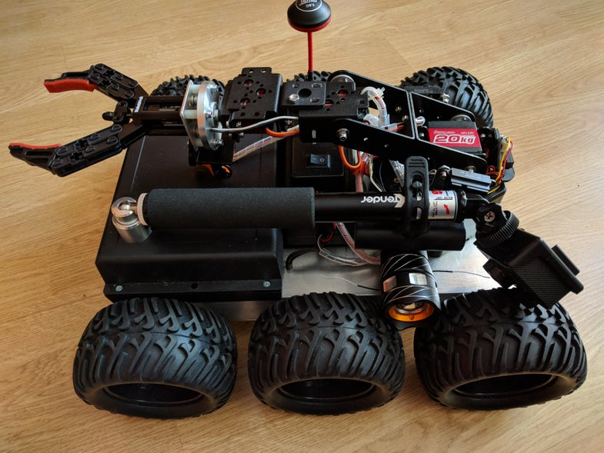
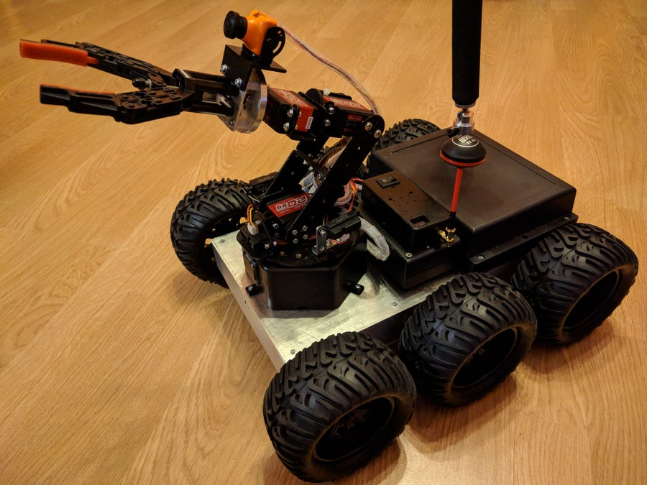
Sample picture

Slide 6
Project Timeline
Note: Write in the below table what u will be achieving in each phase
Phase 1
20/10/22
Phase 2
23/11/22
Phase 3

Slide 7
Q&A

Slide 8
Thank you !!

